Slide 1
Batteries and their varieties based on high-energy electrochemical systems
Fyodor Malchik

Slide 2
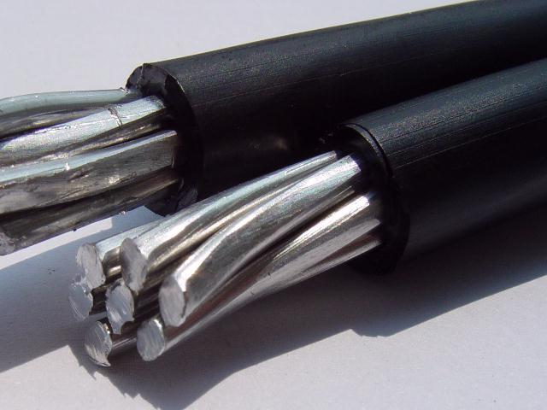
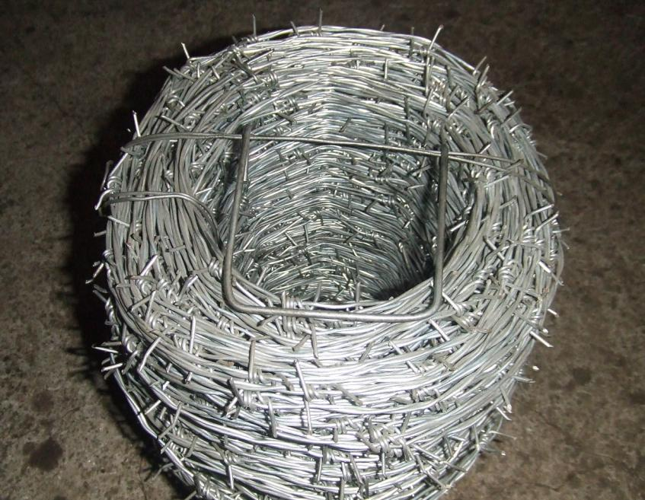
Good conductor:
It is a substance, which conducts electricity fully and freely.
EX: Metals like Copper, Aluminum, and Iron.

Slide 3
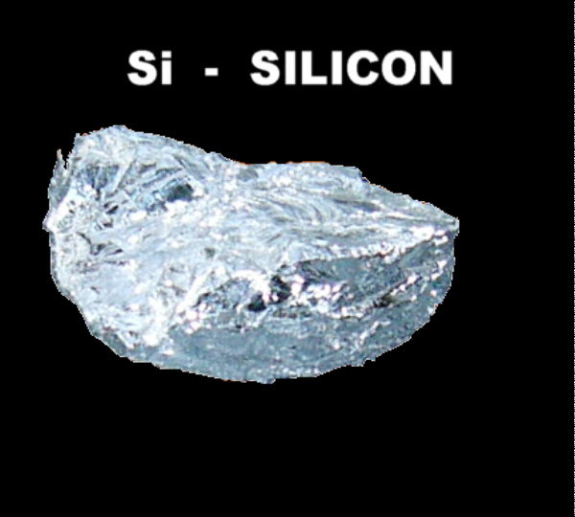
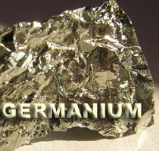
Semi- conductor:
It is a substance, which partially conducts electricity.
EX: Silicon, Germanium.

Slide 4
The following reactions take place in the cell.
At Anode:
Zn → Zn⁺² + 2e⁻ (oxidation or de-elecronation)
At cathode:
Cu⁺² + 2e⁻ → Cu ( Reduction or electronatioin)
The movement of electrons from Zn to cu produces a current in the circuit.
The overall cell reaction is: Zn +Cu⁺² → Zn⁺² +Cu
The galvanic cell can be represented by Zn/znso₄//cuso₄/cu

Slide 5
REFERENCE ELECTRODES
An electrode of known potential is called reference electrode.
Hydrogen electrode is the earliest primary reference electrode.
The secondary reference electrodes discussed here are
1)Calomel electrode
2)Quinhydrone electrode

Slide 6
Types of electrodes
Primary & secondary reference electrodes :
Standard hydrogen electrode(SHE):It is a primary reference electrode. The emf of such a cell is arbitrarily been fixed as zero.
construction:
It consists of a small platinum electrode coated with platinum black immersed in a 1M solution of H⁺ ions maintained at 25⁰c.
Hydrogen gas at one atmosphere pressure enters the glass hood and bubbles over the platinum electrode.
The H₂ gas at the platinum electrode passes into the solution forming H⁺ ions & electrons. H₂→2H⁺ +2e⁻

Slide 7
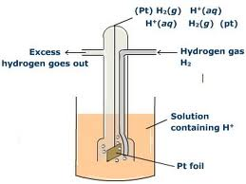
By convention the standard electrode potential of hydrogen electrode when the hydrogen gas passed at one atmosphere pressure is bubbled through a solution of hydrogen ions of unit concentration is orbitarily fixed as zero.
Nernst equation:
At latm
E_{pt,}H_{2/}H⁺ = E⁰_{pt,}H_{2/H+}- 0.059
=E⁰_{pt,} H₂/H⁺ + 0.059 p^{H}
log a_{H+}

Slide 8
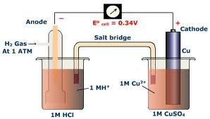
Depending on a half cell to which it is attached hydrogen electrode can act as a cathode or an anode.
But in the given figure hydrogen electrode is connected to copper electrode & it act as anode ,when it is acting as anode ,oxidation takes place.
1/2H₂(g)(1atm)→ H⁺ (1M)+e

Slide 9
Calomel electrode
The calomel electrode consists of a glass tube having two side tubes. A small quantity of pure mercury is placed at the bottom of the vessel and is covered with a paste of Hg and Hg₂ Cl₂.
KCl solution of known concentration is filled through side tube, Shown on the right side of the vessel.
The KCl sol. is filled in the left side tube which helps to make a connection through a salt bridge with the other electrode, which potential has to be determined.
A ‘pt’ wire is sealed into a glass tube as shown in the fig which is in contact with Hg.
When the cell is set up it is immersed in the given solution.

Slide 10
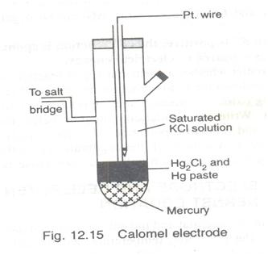
The electrode potentials of calomel electrode of different concentrations at 25⁰c are
0.1 M KCl/ Hg₂cl₂ (s) / Hg,pt → 0.33v
1M KCl / H g₂cl₂ (s) / Hg,pt
→
0.28v
Saturated kcl /Hg₂ cl₂ (s) /Hg, pt
→
0.24v
The corresponding electrode reaction is
Hg₂ Cl₂ + 2e⁻ →
2Hg + 2cl⁻

Slide 11
Glass electrode
Glass electrode is one of the type of ion selective electrode. (ISE). It is is made up of glass tube ended with small glass bulb sensitive to protons.
Glass electrode
The tube has strong and thick walls and the bulb is made as thin as possible.
Inside of the electrode is usually filled with buffered solution of chlorides in which silver wire is covered with AgCl is immersed. The pH of internal solution can be varies.
In this electrode, active part of electrode is the glass bulb. The surface of the glass is protonated by both internal and external solution till equilibrium is achieved.

Slide 12
Both sides of the glass are changed by the absorbed protons. And this charge is responsible for potential difference.
This potential is directly proportional to the pH difference between the solutions on both sides of the glass.
Glass electrode work in the pH range of 1-12 the glass electrode may be represented as
Ag, AgCl/ Hcl (0.1N) / glass / H⁺ (unknown)
Here Ag/AgCl acts as internal reference electrode.

Slide 13
Glass electrode diagram

Slide 14
Nernst equation
Nernst studied the theoretical relationship between electrode reaction and the corresponding cell e.m.f. This relationship generally Known as Nernst equation.
Consider a galvanic cell aA + bB → cC + dD.
Where a,b,c,d represents no. of moles respectively at equilibrium.
The Nernst eq’ for the cell is written as
-

Slide 15
- 2.303
In the above eq’ R= 8.314 J/K. T=298K, F=96, 500 columbs.
By substituting the values in the eq’
- 0.0591
Applications: 1.It can be used to study the effect of electrolyte concentration on electrode potential. 2.the ph of the solution can be calculated from the measurement of emf and Nernst equation. 3.Nernst equation can also be used for finding the valency of an ions or the number of electrons involved in the electrode reaction

Slide 16
Electrochemical series
When the metals are arranged in the order of increasing reduction potentials or decreasing oxidation potentials which are determined with respect to one molar solutions of their ions and measured on the hydrogen scale, along series or list, resulted is called electrochemical or galvanic series.
The higher a metal is in the series, the greater is its tendency to be oxidized.
Applications : 1. relative corrosion tendencies of the metals& alloys.
2.relative ease of oxidation or reduction of metals. 3.replacement tendency of metals.

Slide 17
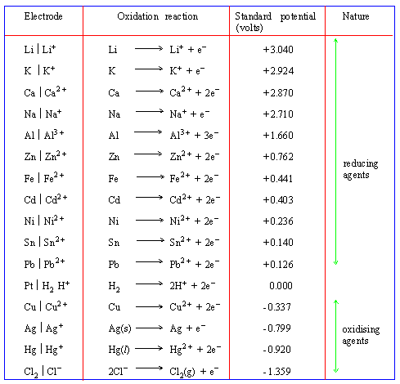
STANDARD REDUCTION POTENTIAL

Slide 18
Batteries & Fuel Cells
A history in pictures

Slide 19
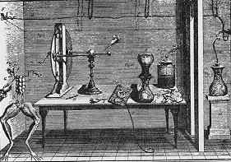
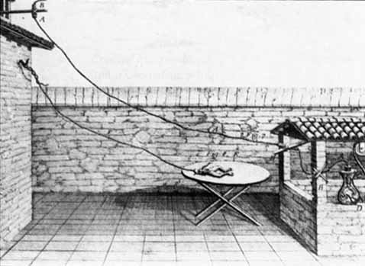
1771-1800: The Galvani-Volta Controversy
Luigi Galvani “Animal Electricity
Alessandro Volta

Slide 20
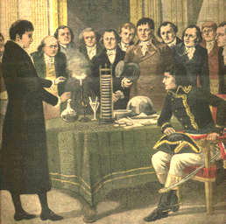
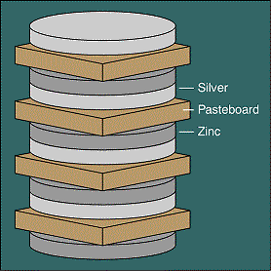
1800: The First Battery (Voltaic Pile)
1801: Volta presenting his battery to Napoleon

Slide 21
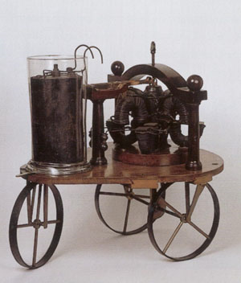
1821: The First Electric Motor 1835: The First BEV (Battery Electric Vehicle)
Michael Faraday
Sibrandus Stratingh

Slide 22
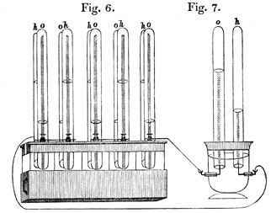
1839: First Fuel Cell (Grove’s “Gas Battery”)
Sir William Grove

Slide 24
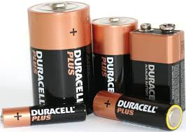
BATTERIES
They are electrochemical cells connected in series
Batteries are Store houses of electrical energy
They are used as a source of direct electric current at constant voltage.
They are classified into two types
i) Primary cell
ii) Secondary cell

Slide 25
Methanol-oxygen fuel cell:
In this cell, CH₃OH is used as a fuel & O₂ as a oxidant to generate electric current. This cell has two electrodes.
porous nickel electrode coated with pt/pd catalyst act as anode & coated with silver catalyst act as cathode.
The electrolyte KOH taken is in between two electrodes.

Slide 26
Reactions:
At anode:CH₃OH + 6OH⁻ → CO₂+5H₂O+6e⁻
At cathode:3/2O₂ + 3H₂O + 6e⁻ → 6OH⁻
Net reaction:CH₃OH +3/2O₂ → CO₂ +2H₂O
Advantages : 1.These cells are reasonably stable at all environmental conditions.
2.Easy to transport.
3.Do not require complex steam reforming operations.
4.Methanol posses less risk to aquatic plants, animals & human beings than gasoline.

Slide 27
Advantages of fuel cells
1.The reactants and products are environment friendly.
2.High efficiency of energy conversion from chemical energy to electrical energy.
3.The fuels and electrolyte materials are available in plenty and inexhaustible unlike fossil fuel.
4.Fuel cells are operatable to 200 degree centigrade and so finds applications in high temperature systems.
5.Fuel energy is economical and safe.
6.Fuel cells are compact & transportabe.

